Slide 1
Lecture 8
Implementation Levels of Virtualization
Para Virtualization
Full Virtualization

Slide 2
Virtual Machines
VMs are created from Physical Machines, to enhance resource sharing, and improve computer performance in terms of resource utilization
Multiple virtual machines (VMs) are multiplexed in the same hardware machine
Hardware resources (CPU, memory, I/O devices, etc.) or software resources (operating system and software libraries) can be virtualized in various functional layers

Slide 3
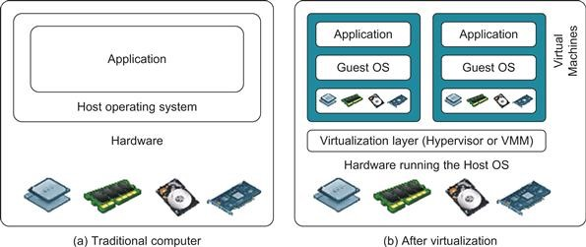
Architecture of Computer System Before and After Virtualization

Slide 4
A traditional computer runs with a host operating system specially tailored for its hardware architecture
After virtualization, different user applications managed by their own operating systems (guest OS) can run on the same hardware, independent of the host OS.
This is often done by adding additional software, called a virtualization layer — Hypervisor/ Virtual Machine Manager (VMM)
The VMs are shown(previous slide) , where applications run with their own guest OS over the virtualized CPU, memory, and I/O resources
The virtualization software creates the abstraction of VMs by interposing a virtualization layer at various levels of a computer system
Common virtualization layers include the instruction set architecture (ISA) level, hardware level, operating system level, library support level virtualization

Slide 5
Instruction Set Architecture Level (ISA)
Instruction set virtualization enables the running of applications and virtual machines designed for one processor to run on other processors with different instruction set architectures

Slide 6
Activity happenings within the Instruction Set Architecture Level (ISA)
Instruction set
The hardware on the physical server in cloud computing has its own instruction set that it will process.
Emulator
The emulator serves as an interpreter, and the fundamental role of this is to set communication between the virtualization and hardware layers in cloud computing

Slide 7
Mapping of the instruction
Instructions that the emulator gets for the resources from the virtual machine can get mapped to the hardware instruction presented in the host machine.
Therefore, after the processing emulator got the result back from the host machine, it sent services to the user with the help of the virtual machine

Slide 8
Hardware Abstraction Level (HAL)
Hardware-Abstraction level virtualization is available right on top of the bare hardware. On the one side, this approach produces a virtual hardware environment for a VM.
On the other side, the process controls the underlying hardware through virtualization.
Therefore, the purpose is to virtualize computer resources, such as processors, memory, and I/O devices.

Slide 9
Hardware resources in the host machine get mapped using a virtualization layer to the virtual resources present on the guest operating system.
Hence, virtualized computing system holds thousands of resources. All of them need some directions for processing, which is not an easy task. And due to, this instruction was classified into two primary forms to make the processing smooth
Non-privileged instruction– These instructions execute directly without interfering with other tasks.
Privileged instruction– These instructions require some modification before it executes.

Slide 10
Operating System Level
Operating system based Virtualization refers to an operating system feature in which the kernel enables the existence of various isolated user-space instances.
The installation of virtualization software also refers to Operating system-based virtualization. It is installed over a pre-existing operating system and that operating system is called the host operating system.

Slide 11
In this virtualization, a user installs the virtualization software in the operating system of his physical machine like any other program and utilize this application to operate and generate various virtual machines.
Here, the virtualization software allows direct access to any of the created virtual machine to the user.

Slide 12
Library-level virtualization
Library-level virtualization is also known as API emulation
This type of virtualization can create execution environments for running alien programs on a platform rather than creating a VM to run the entire operating system.

Slide 13
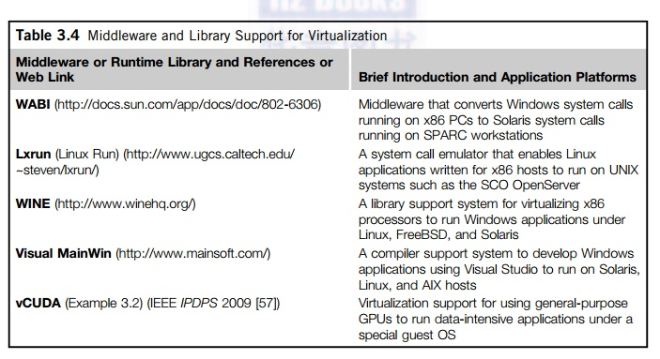

Slide 14
Understanding Paravirtualization and Full virtualization

Slide 15
OS Recap
In order to understand how a Para virtualization and Full virtualization works, we need to know how operating systems manage the underlying hardware
Think about a simple application task like browsing a website
If you want to browse a website, your browser application has to use the network card and it has to make a system call in order for that to occur

Slide 16
Some operating system components can directly access your hardware
In order to manage these different privilege levels, modern x86 CPUs have different execution privilege groups called rings
Each ring has different restrictions on the type of operations that can be performed by the CPU
For example, device drivers and the kernel usually run in Ring 0 which grants the highest permission level, while user applications always run in the least privilege ring

Slide 17
This also applies to virtual machine themselves. Virtual machines require an operating system and this OS requires Ring 0 authority
As a guest OS unable to access Ring 0 directly, it must obtain Ring 0 privilege
Hypervisors usually solve this problem with either Para or Full Virtualization.

Slide 18
Para virtualization
In the Para virtualization method when a privilege command must be executed on the Guest OS
it is delivered to the hypervisor through a hypercall, a kind of system call
When the hypervisor receives this hypercall, it accesses the hardware and returns the result.

Slide 19
Para virtualization requires some modifications to the guest operating system kernel in order to use the hypercall mechanism.
Thanks to hypercalls, virtual machines applications and operating systems run in CPU Ring 3, the least privileged CPU mode.
Therefor a guest OS is recompiled prior to installation inside a virtual machine. In para-virtualization, the guest OS is modified to enable communication with the hypervisor to improve performance and efficiency.
VMware and Xen are supported by this type of virtualization.

Slide 20
Full Virtualization
In full virtualization the idea is to leave the operating system pretty much unmodified so you can run the guest operating system on top of the hypervisor, as it will run natively on the real hardware
This is called full virtualization because the operating system is completely untouched.
Nothing has been changed. Not even a single line of code is modified in these operating systems in order to run on the hypervisor simultaneously.

Slide 21
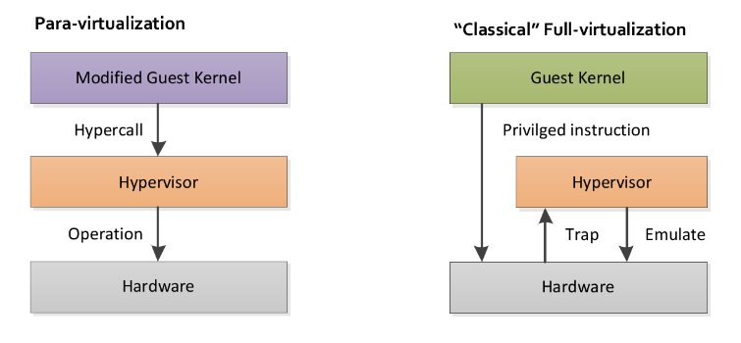

Slide 22
The Trap and Emulate Strategy
Operating systems running on top of the hypervisor are run as user-level processes. They are not running at the same level of privilege as a host operating system that is running on bare metal as though running in ring 0 of the CPU.
But if the operating system code is unchanged, it doesn’t know that it does not have the privilege for doing certain things that it would do normally on bare metal hardware.

Slide 23
In other words, when the operating system executes some privileged instructions, meaning they have to be in a privileged mode or kernel mode to run on bare metal in order to execute those instructions
Those instructions will create a trap that goes into the hypervisor and the hypervisor will then emulate the intended functionality of the operating system.
This is what is called the trap and emulate strategy.

Slide 24
Trap and Emulate Strategy contd
Attempting a privileged instruction when in user mode causes an error to occur thus leading to trap state.
And after this the VMM (Virtual Machine Manager) gets control and analyzed the error , executes the operation as attempted by the guest and then return the control back to guest in user mode.
Note : Kernel mode privileged command runs slower due to trap and emulate

Slide 25
The guest operating system makes system calls to the emulated hardware.
These calls, which would actually interact with underlying hardware, are intercepted by the virtualization hypervisor through “trap” which maps them onto the real underlying hardware.
The products support this virtualization are VMware, Microsoft, and KVM.

Slide 26
